Slide 2
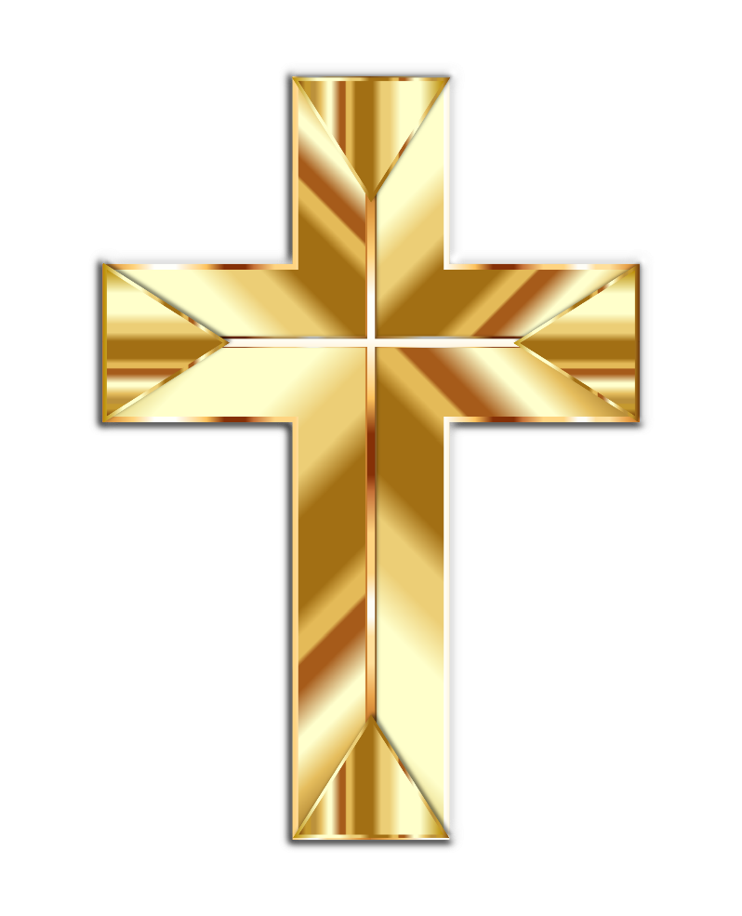
Sign of the Cross
In the name of the Father,
and of the Son,
and of the Holy Spirit.
Amen.

Slide 3
Morning Prayer
O my God, you love me,
you are with me night and day.
I want to love you always
in all I do and say.
I’ll try to please you, Father,
bless me through the day.
Amen.

Slide 4
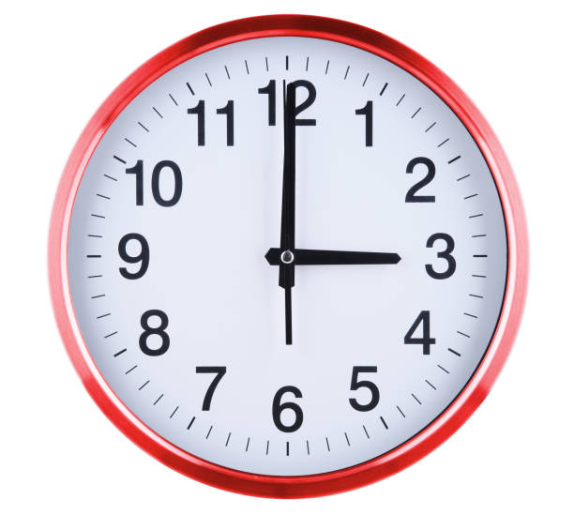
Prayer at the end of the day
God our Father, I come to say
thank you for your love today.
Thank you for my family
and all the friends you give to me.
Guard me in the dark of night
and in the morning send your light.
Amen.

Slide 6
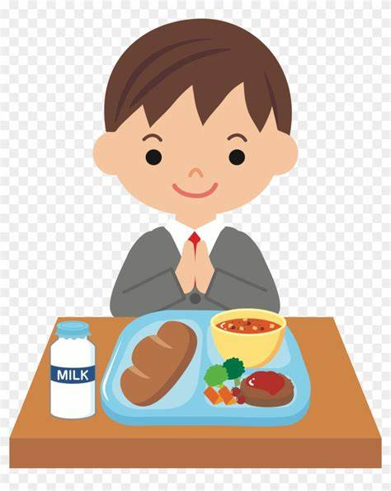
Grace Before Meals
Diolch i Ti am y byd
Diolch am ein bwyd bob dydd
Diolch am yr haul a’r glaw
Diolch Dduw am bopeth ddaw.
Amen

Slide 7
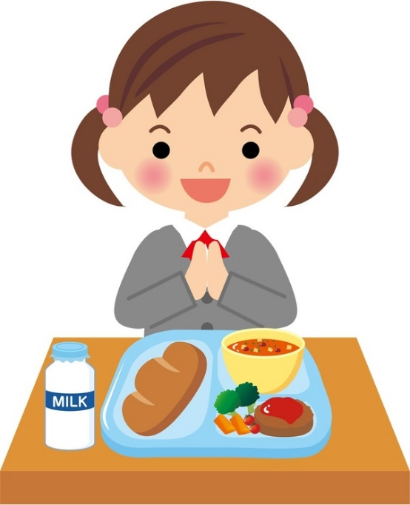
Grace after meals
Thank you, God, for the food we have eaten.
Thank you, God, for all our friends.
Thank you, God, for everything,
Thank you God.
Amen.

Slide 8
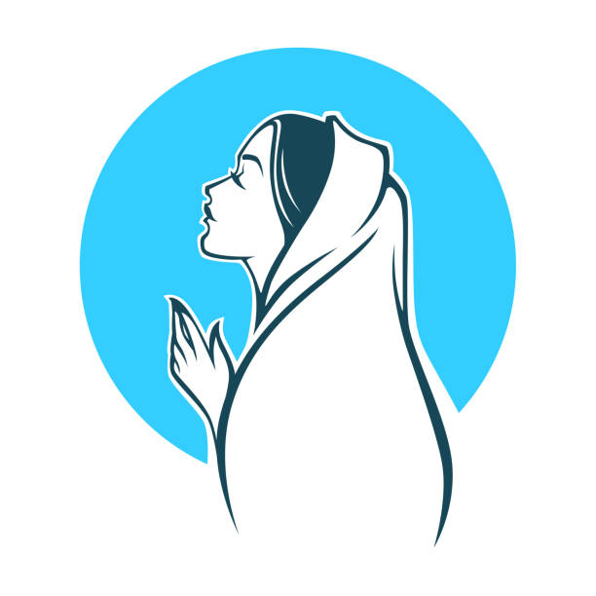
Hail Mary
Hail Mary, full of grace,
the Lord is with thee:
blessed art thou among women,
and blessed is the fruit of thy womb, Jesus.
Holy Mary, Mother of God,
pray for us sinners,
now and at the hour of our death.
Amen.

Slide 9
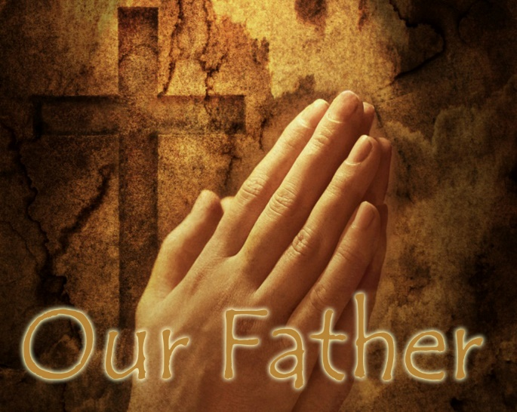
Our Father
Our Father, who art in heaven,
hallowed be thy name.
Thy kingdom come.
Thy will be done on earth, as it is in heaven.
Give us this day our daily bread,
and forgive us our trespasses,
as we forgive those who trespass against us.
And lead us not into temptation,
but deliver us from evil.
Amen.

Slide 11
Hail Mary
Hail Mary, full of grace,
the Lord is with thee:
blessed art thou among women,
and blessed is the fruit of thy womb, Jesus.
Holy Mary, Mother of God,
pray for us sinners,
now and at the hour of our death.
Amen.

Slide 12
Our Father
Our Father, who art in heaven,
hallowed be thy name.
Thy kingdom come.
Thy will be done on earth, as it is in heaven.
Give us this day our daily bread,
and forgive us our trespasses,
as we forgive those who trespass against us.
And lead us not into temptation,
but deliver us from evil.
Amen.

Slide 13
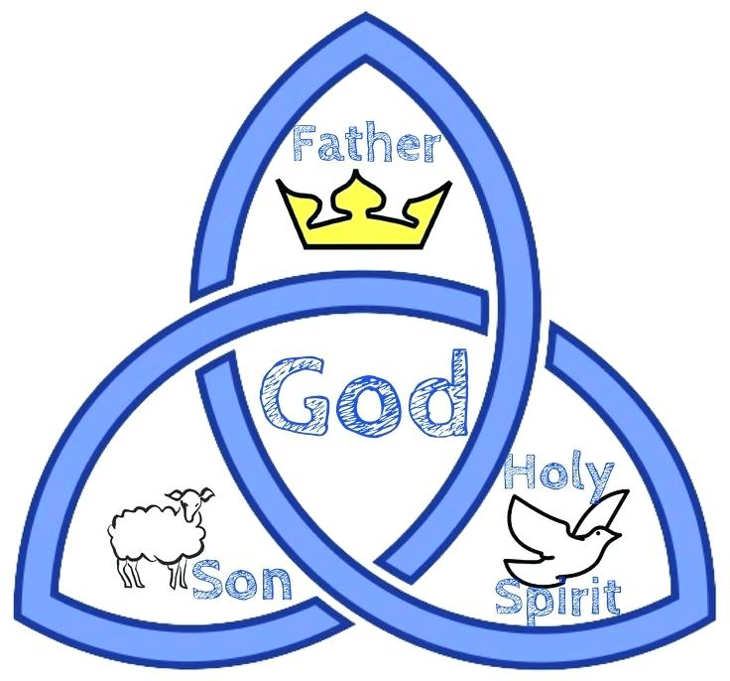
Glory Be
Glory be to the Father,
and to the Son,
and to the Holy Spirit,
as it was in the beginning,
is now, and ever shall be,
world without end.
Amen.

Slide 15
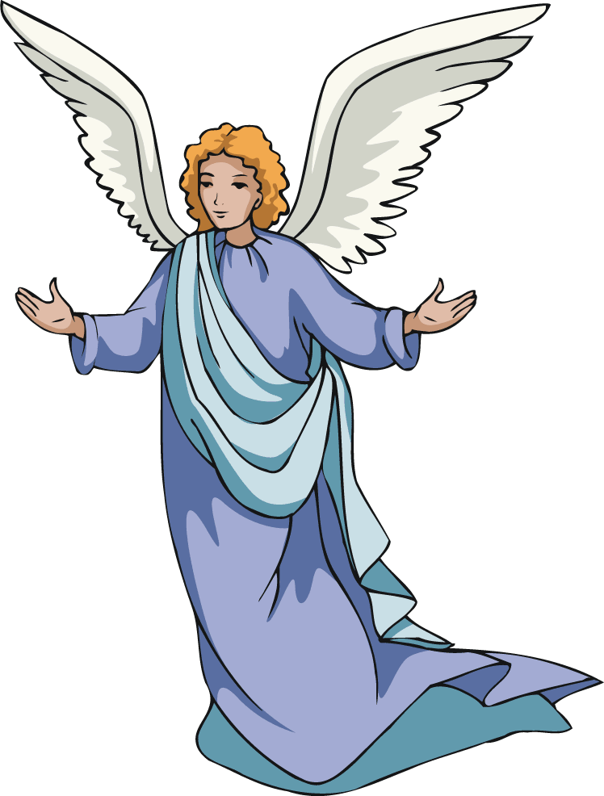
Prayer to the Guardian Angel
Angel of God, my guardian dear, to whom God's love commits me here, ever this day be at my side, to light and guard, to rule and guide. Amen.

Slide 16
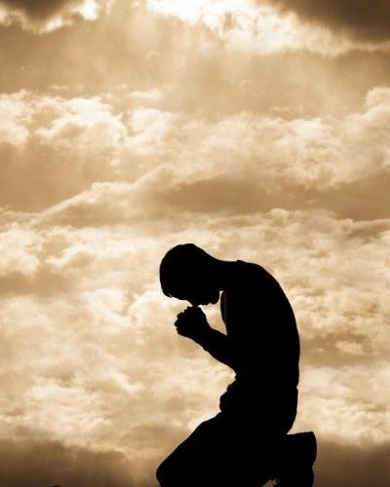
Act of Sorrow
O my God, I thank you for loving me.
I am sorry for all my sins:
for not loving others
and not loving you.
Help me to live like Jesus
and not sin again.
Amen.

Slide 18
Eternal Rest
Eternal rest give unto them, O Lord,
and let perpetual light shine upon them.
May they rest in peace.
Amen.

Slide 19
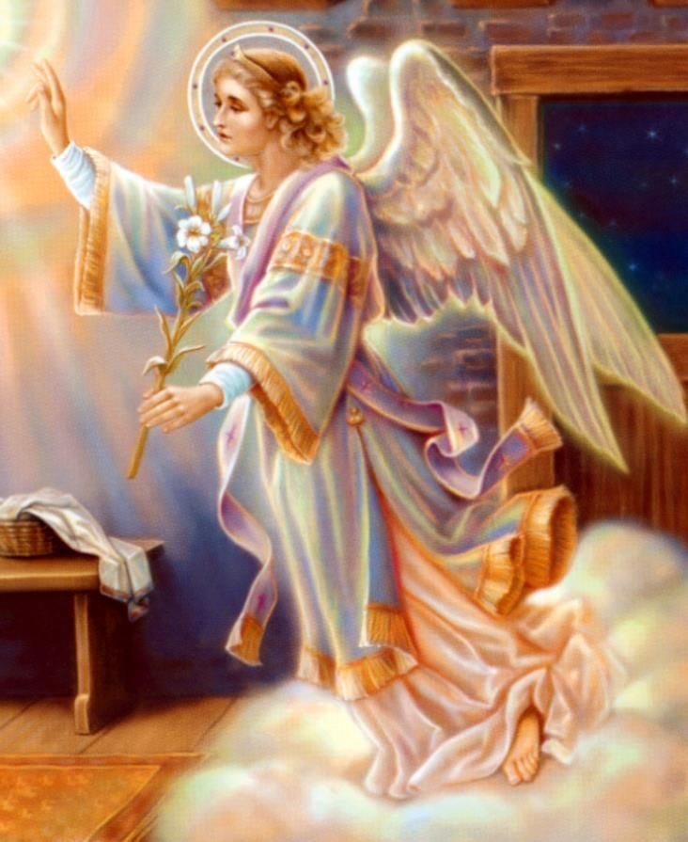
Angel of God
Angel of God,
my guardian dear,
to whom God’s love commits me here,
ever this day be at my side,
to light and guard,
to rule and guide.
Amen.

Slide 20
YEAR 4

Slide 21
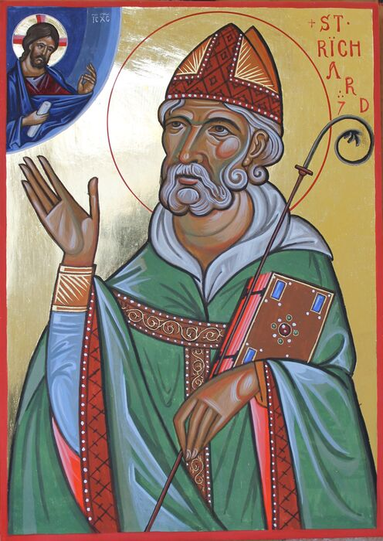
Prayer of St Richard of Chichester
Thanks be to you, my Lord Jesus Christ,
for all the benefits which you have given me,
for all the pains and insults which you have borne for me.
O most merciful Redeemer, friend and brother,
may I know you more clearly,
love you more dearly,
and follow you more nearly,
day by day.
Amen.

Slide 22
Come Holy Spirit
V. Come, Holy Spirit, fill the hearts of your faithful.
R. And kindle in them the fire of your love.
V. Send forth your Spirit and they shall be created.
R. And you will renew the face of the earth.
Let us pray
O God, who by the light of the Holy Spirit,
did instruct the hearts of your faithful,
grant that by that same Holy Spirit,
we may be truly wise, and ever rejoice in your consolation,
Through Christ our Lord.
Amen.

Slide 23
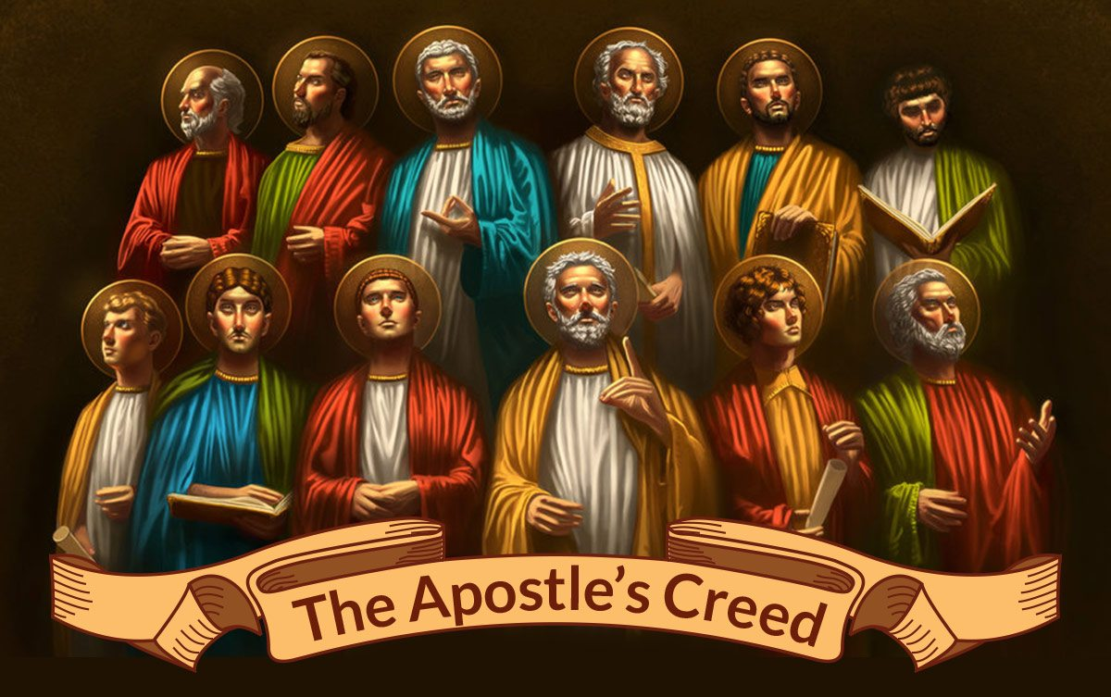
I believe in God,
the Father almighty
Creator of heaven and earth,
and in Jesus Christ, his only Son, our Lord,
(At the words that follow, up to and including the Virgin Mary, all bow.)
who was conceived by the Holy Spirit,
born of the Virgin Mary,
suffered under Pontius Pilate,
was crucified, died and was buried;
he descended into hell;
on the third day he rose again from the dead;
he ascended into heaven,
and is seated at the right hand of God the Father almighty;
from there he will come to judge the living and the dead.
I believe in the Holy Spirit,
the holy catholic Church,
the communion of saints,
the forgiveness of sins, the resurrection of the body,
and life everlasting.
Amen.
The Apostles Creed

Slide 24
YEAR 5

Slide 25
Morning Offering
O Jesus,
through the most pure heart of Mary,
I offer you all my prayers, thoughts, works and sufferings
of this day for all the intentions of your most Sacred heart.

Slide 26
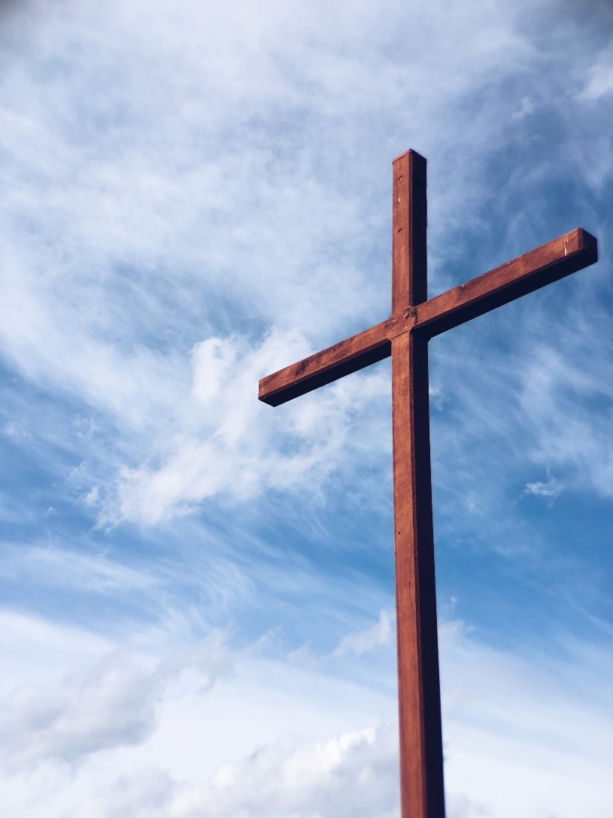
Act of Faith
My God,
I believe in you
and all that your Church teaches,
because you have said it,
and your word is true.

Slide 27
Act of Hope
My God, I hope in you,
for grace and for glory,
because of your promises,
your mercy and your power.

Slide 28
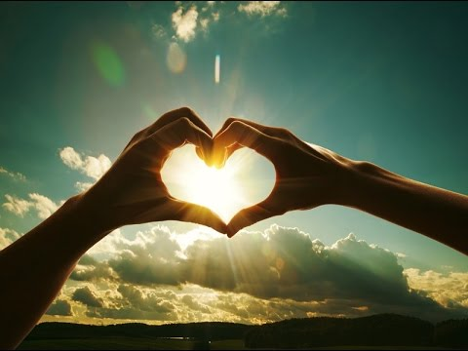
Act of Love
My God, because you are so good,
I love you with all my heart,
and for your sake,
I love your neighbour as myself.

Slide 29
YEAR 6

Slide 30
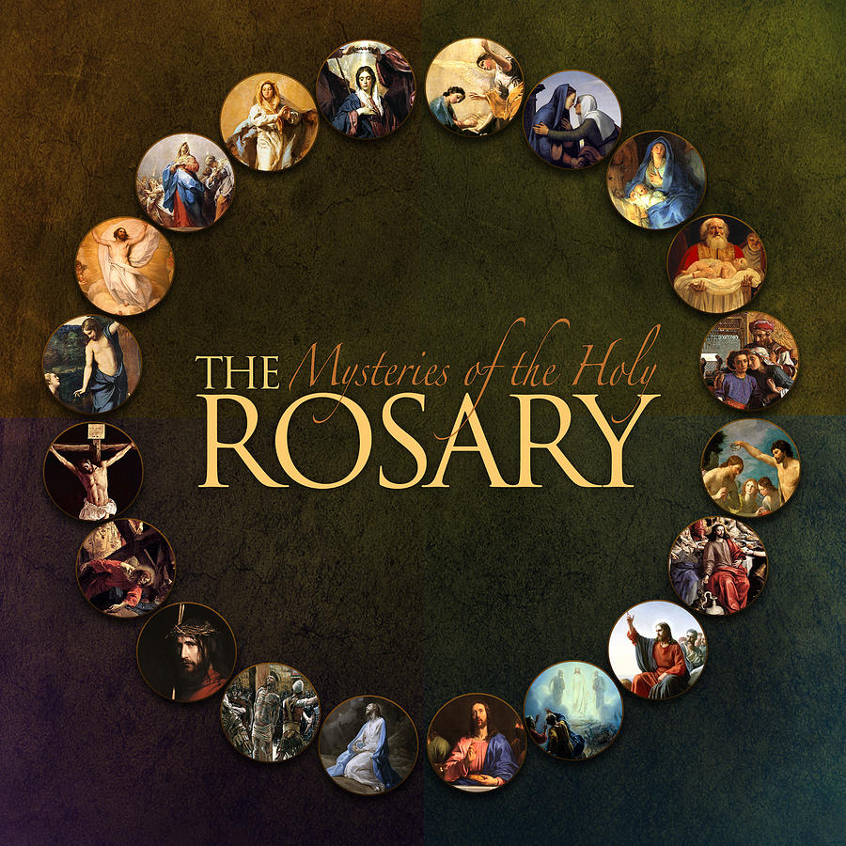
The Rosary

Slide 31
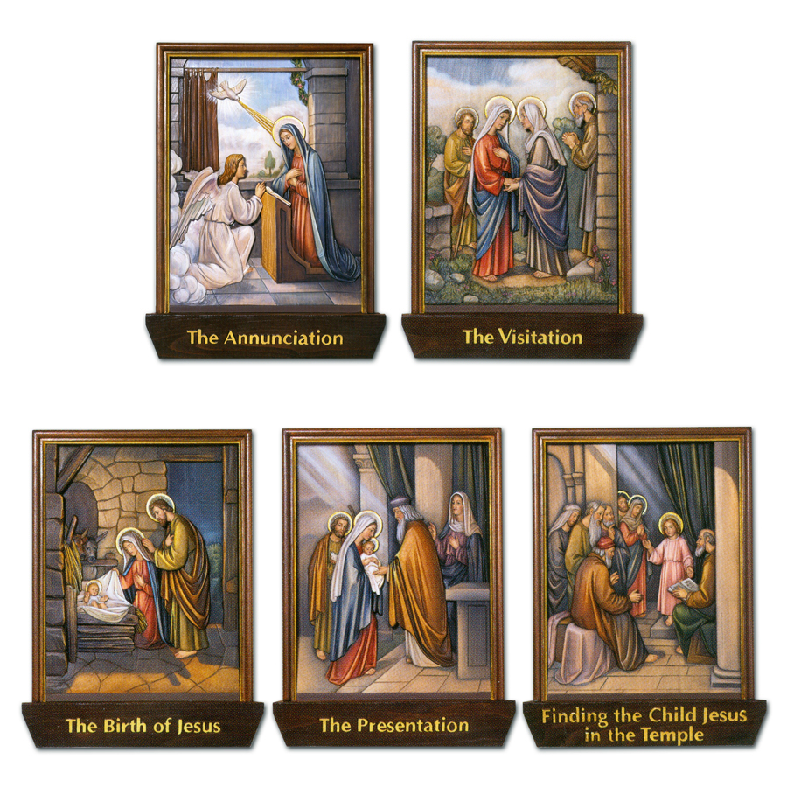
The Joyful Mysteries
(Recited Monday and Saturday)
The Annunciation (Luke 1:26–38)
The Visitation (Luke 1:39–45)
The Nativity (Luke 2:1–7)
Common prayers 75 9.5
The Presentation in the Temple (Luke 2:22–35)
The Finding in the Temple (Luke 2:41–52)

Slide 32
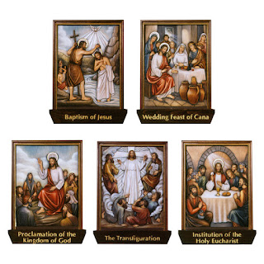
The Mysteries of Light
(Recited Thursday)
The Baptism of Jesus (Matthew 3:13–17)
The Wedding Feast of Cana (John 2:1–12)
The Proclamation of the Kingdom, with the call to Conversion (Mark 1:14–15; 2:3–12)
The Transfiguration (Luke 9:28–36)
The Institution of the Eucharist (Matthew 26:26–29)

Slide 33
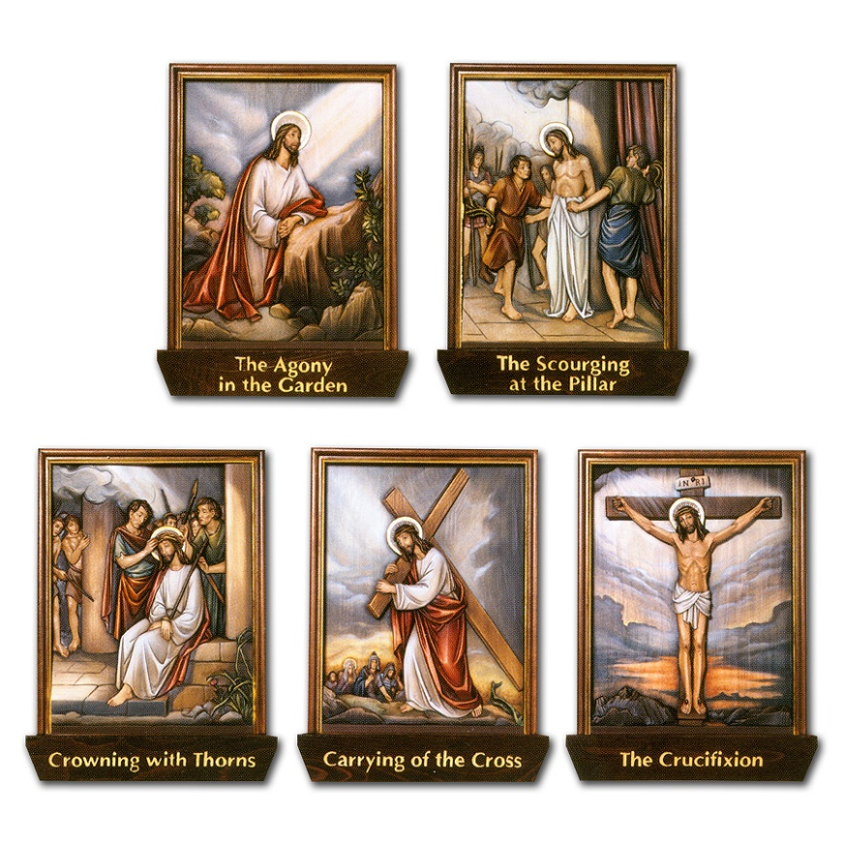
The Sorrowful Mysteries
(Recited Tuesday and Friday)
The Agony in the Garden (Mark 14:32–42)
The Scourging at the Pillar (Matthew 27:15–26)
The Crowning with Thorns (Matthew 27:27–31)
The Carrying of the Cross (John 19:15–17; Luke 23:27–32)
The Crucifixion (Luke 23:33–38, 44–46)

Slide 34
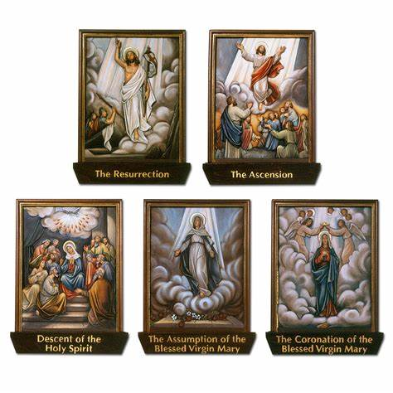
The Glorious Mysteries
(Recited Wednesday and Sunday)
The Resurrection (Matthew 28:1–8)
The Ascension (Acts 1:6–11)
The Descent of the Holy Spirit (Acts 2:1–12)
The Assumption (1 Thessalonians 4:13–19)
The Coronation of Mary Queen of Heaven and Earth (Revelation 12:1; 14:1–5; Isaiah 6:1–3)

Slide 35
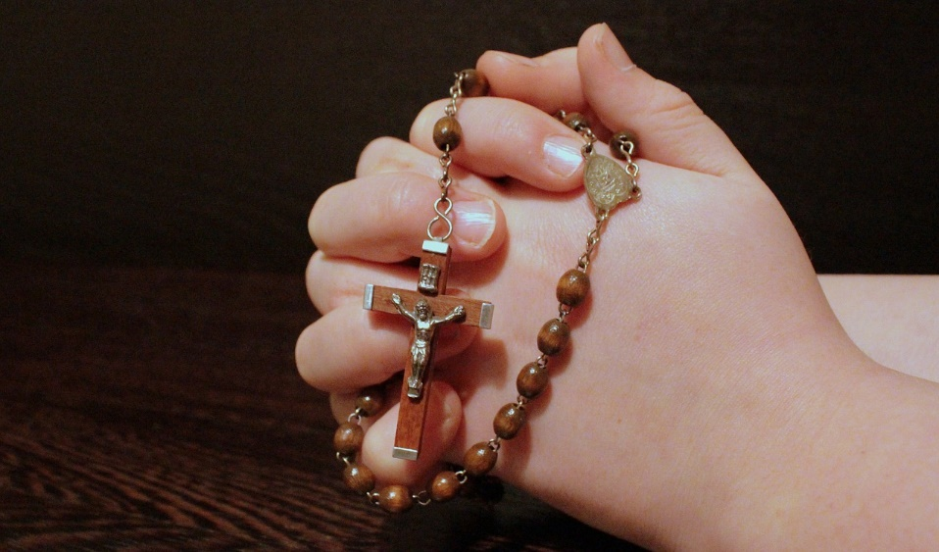
Prayer concluding the Rosary
V. Pray for us, O holy Mother of God.
R. That we may be made worthy of the promises of Christ.
Let us pray.
O God, whose only-begotten Son,
by his life, death and resurrection,
has purchased for us the rewards of eternal life,
grant, we beseech thee,
that meditating on these mysteries
of the most holy Rosary of the Blessed Virgin Mary,
we may imitate what they contain
and obtain what they promise,
through the same Christ our Lord.
Amen.

Slide 36
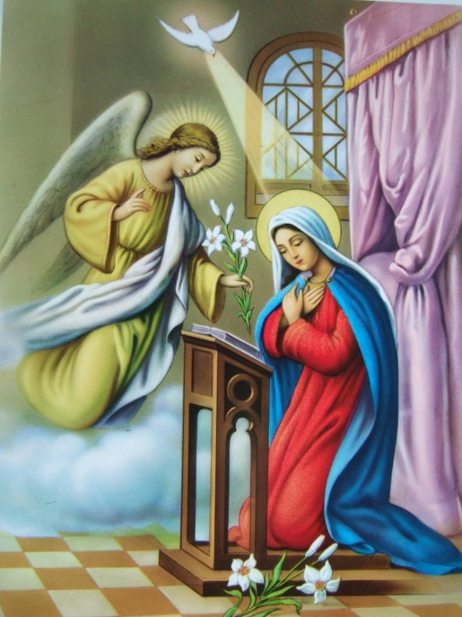
The Magnificat
My soul glorifies the Lord,
My spirit rejoices in God, my Saviour.
He looks on his servant in her loneliness;
henceforth all ages will call me blessed.
The Almighty works marvels for me.
Holy his name!
His mercy is from age to age,
on those who fear him.

Slide 37
He puts forth his arm in strength
and scatters the proud-hearted.
He casts the mighty from their thrones
and raises the lowly.
He fills the starving with good things,
sends the rich away empty.
He protects Israel, his servant,
remembering his mercy,
the mercy promised to our fathers,
to Abraham and his sons for ever. Amen.

